Slide 1
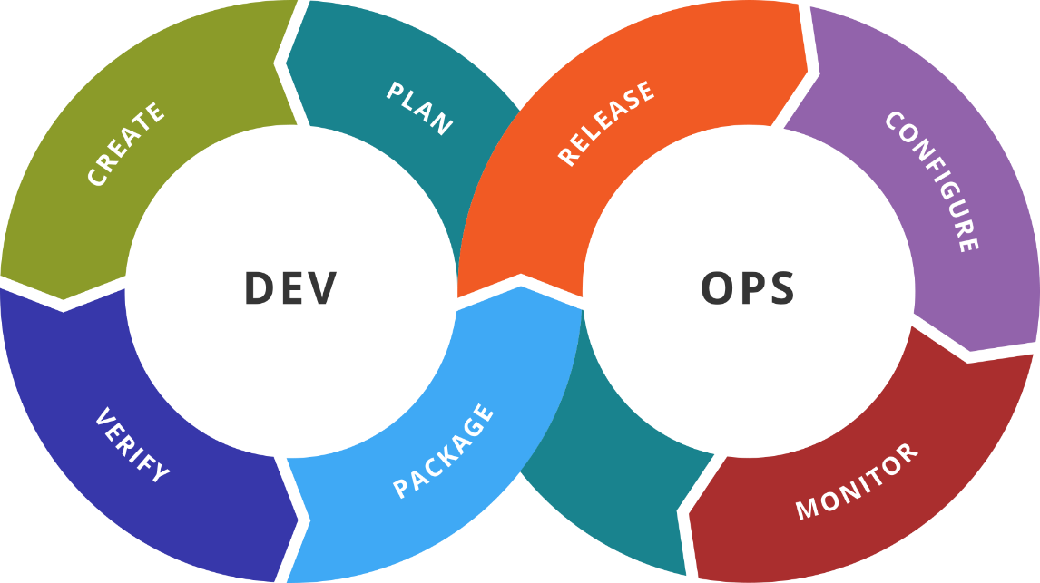
DevOps Fundamentals Course Introduction
Scope, Objective, Target Audience, Schedule
SoftUni Team
Technical Trainers
Software University
http://softuni.bg

Slide 2
You Have Questions?
sli.do #Dev-Fund

Slide 3

Table of Contents
Course objectives, scope, and schedule
Infrastructure
Exercises and labs
Examination

Slide 4

Course Scope and Objectives

Slide 5
Course Objectives
Use bash and Python for automation
Working with Terraform, Packer, and Vault
Working with Kubernetes
Working with git
Working with NoSQL databases
Working with ELK Stack

Slide 6
Course Scope and Schedule (1)
Week #1
Infrastructure as Code
Getting to Know Terraform
Applying Additional Techniques
Week #2
Container Orchestration
Getting to Know Kubernetes
Working with Kubernetes

Slide 7
Course Scope and Schedule (2)
Week #3
Kubernetes in Detail
Advanced Scenarios
Week #4
Scripting Languages in Automation
BASH
Python

Slide 8
Course Scope and Schedule (3)
Week #5
Git
Packer and Vault
Week #6
NoSQL Databases
Installation and Configuration

Slide 9
Course Scope and Schedule (4)
Week #7
Extract and Analyze System Information
ELK Stack
Week #8
Exam Preparation

Slide 10

Infrastructure
Requirements and Landscape

Slide 11
Required Resources
CPU with VT-x/AMD-V
6GB+ RAM, 60GB+ HDD
Virtualization Software
Any OS
AWS Account

Slide 12

DevOps Fundamentals: Details
Duration, Languages, Technologies

Slide 13

Training Duration
Lectures: ~ 12 hours (onsite + YouTube videos)
Practical exercises (in class): ~ 12 hours
Homework: None
Schedule: December 2018 – February 2019
Practical exam: 10 February 2019
Practical exam II: 17 February 2019

Slide 14

Why English?
Why the slides are in English?
English is the native language of the IT people
Specific terminology should be in English
Translations are inaccurate and funny
Just learn English!
No excuses

Slide 15

DevOps Fundamentals
Exam and Evaluation Criteria

Slide 16






Scoring for Windows System Administration
TEST
0%
TEAM
PLAY
HOMEWORK
PRACTICE
EXAM
100 %
BONUS
0 %
EVALUATION
CRITERIA

Slide 17
Practice
There will be set of tasks
Create the required infrastructure
Deploy and configure the necessary tools and components
Fulfill the requirements in the most automated way possible
Prove the solution is working as per the requirements

Slide 18
Practice is Important
Try to follow in class
Repeat practice at home
Extend the practice with additional tasks
Ask for more ☺

Slide 19

About Me
Just a Few Words

Slide 20
The Trainer
About me
Dimitar Zahariev
During office hours – BI/DI Consultant
openSUSE Advocate and Virtualization Enthusiast
Communication channels
SoftUni Forum
e-mail: dimitar@zahariev.pro
Skype: zahariev.dimitar

Slide 21

Summary
We are ready to move forward.

Slide 23
Diamond Partners

Slide 24
Diamond Partners

Slide 25





Trainings @ Software University (SoftUni)
Software University – High-Quality Education, Profession and Job for Software Developers
softuni.bg
Software University Foundation
http://softuni.foundation/
Software University @ Facebook
facebook.com/SoftwareUniversity
Software University Forums
forum.softuni.bg

Slide 26

License
This course (slides, examples, demos, videos, homework, etc.) is licensed under the "Creative Commons Attribution-NonCommercial-ShareAlike 4.0 International" license

